Slide 1


CAPSTONE PROJECT
BATTLE OF THE NEIGHBOURHOODS-
NEW YORK , CANADA

Slide 2


BACKGROUND
With a large number of people who want to travel and visit places abroad, but with limited funds, it's imperative that they to gain useful data and analysis to aid them pick the best location to visit, according to their preferences.

Slide 3
BACKGROUND CONT.
Most travelers in Africa like to tour America at least once in their lifetime, however, new information circulating here is that Canada is also a great destination for tour.

Slide 4
PURPOSE
The purpose of this project is to compare/contrast various services individually found in these two countries, focusing on two financial cities within them. i.e., New York- America, Toronto- Canada. Services that will be compared will be things like restaurants, and the number of tourist sites.

Slide 5
NOTES
DATA
Information and analysis will be gained directly from Foursquare
METHODOLOGY
I used Pandas and NumPy libraries mainly for the analysis. Also, folium was using in aiding visualization the areas in the form of maps.

Slide 6
SUMMARY
After the data analysis procedures performed in Jupyter Notebook, the maps above were generated. From careful observation of the map and Panda data frames, it can be observed that:
Toronto had a larger number of restaurants than New York.
New York on the other hand had a significant amount of tourist sites than Toronto.

Slide 7
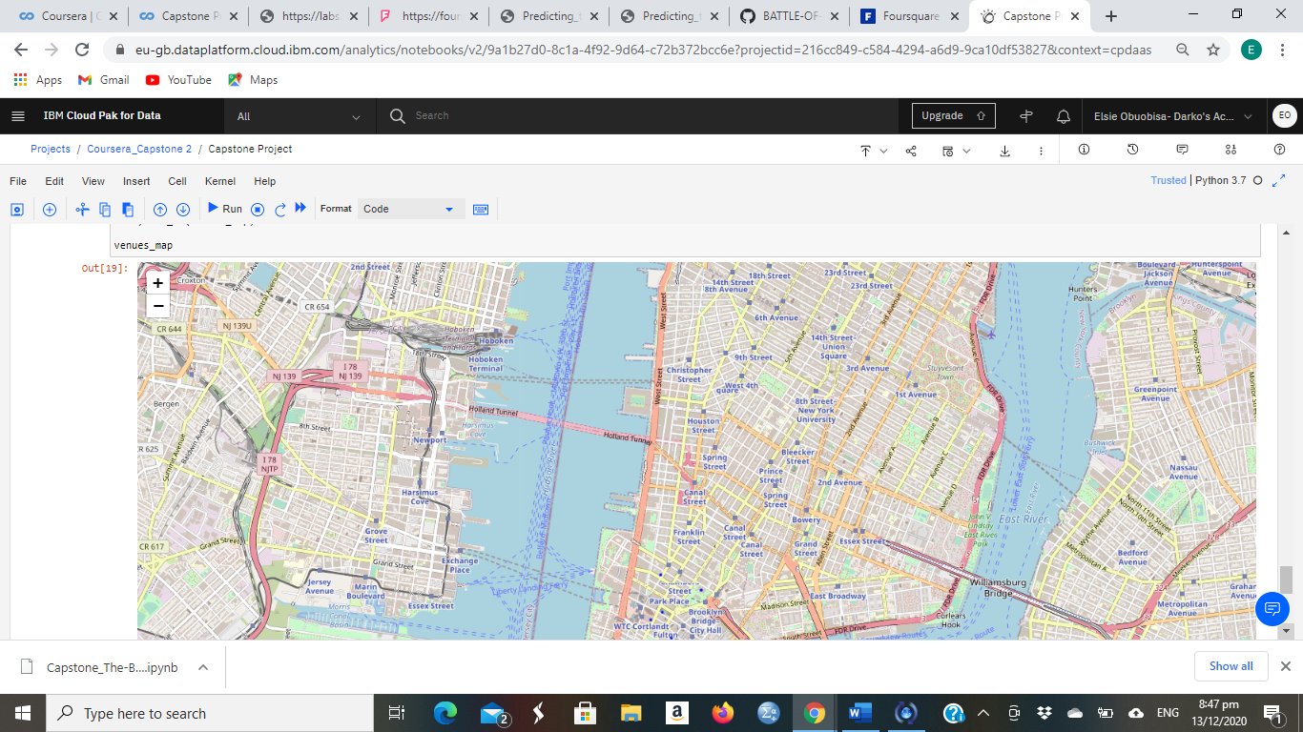
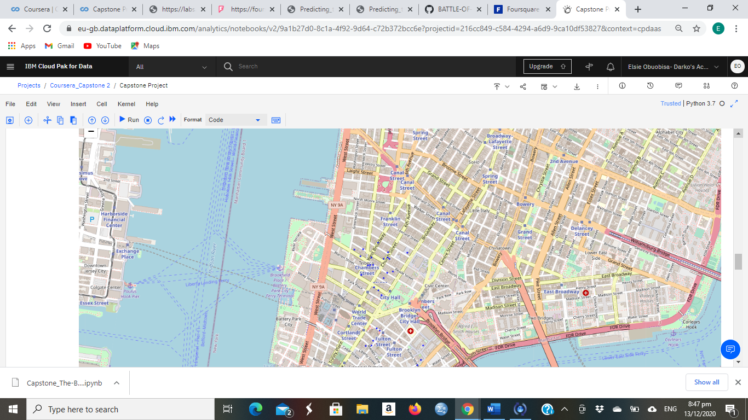
NEW YORK
TOURIST SITES
RESTAURANTS

Slide 8
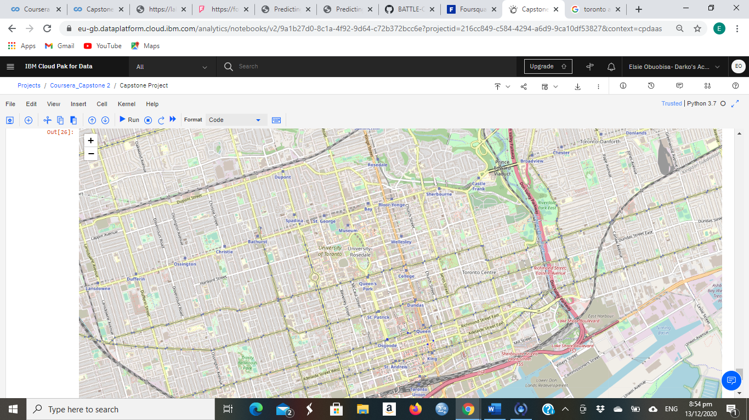
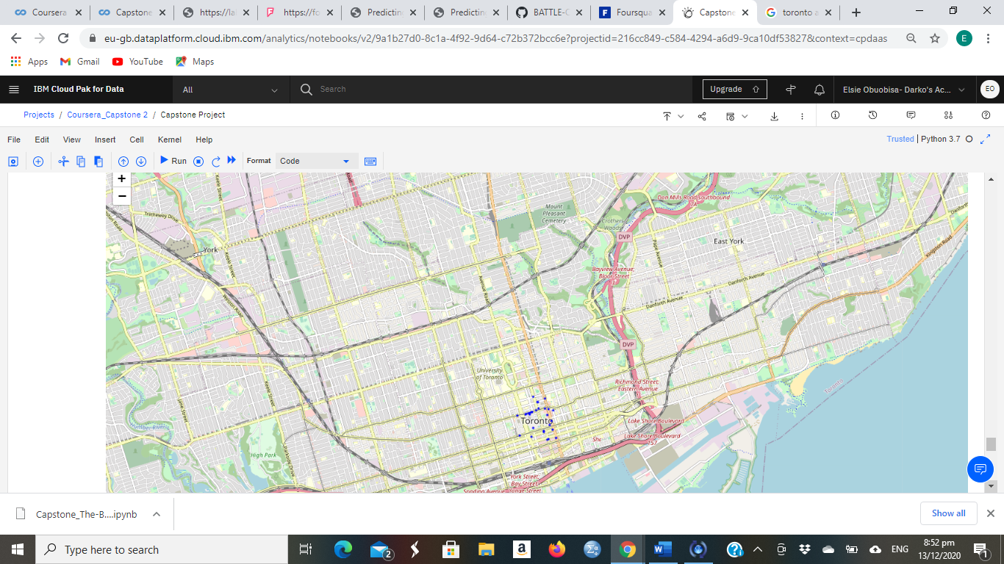
TORONTO
TOURIST SITES
RESTAURANTS

Slide 9
SUMMARY
After the data analysis procedures performed in Jupyter Notebook, the maps above were generated. From careful observation of the map and panda dataframes, it can be observed that:
Toronto had a larger number of restaurants than New York.
New York on the other hand had a significant amount of tourist sites than Toronto.

Slide 10
CONCLUSION
Per the results gained, we can deduce or gather that if a traveler prefers to explore more restaurants and food vendors than tour; Toronto is the better option, however if site seeing and tourist is the paramount reason an individual is motivated to travel by, New York would be a better option due to the larger amount of tourist sites there.

